Slide 1


DevRel Camp
Connecting as One
Notes:
Accessibility review:
Slide Deck numbers should be added to each slide in the bottom right or left hand corner
Add Alt Text to all images

Slide 2




Data Platform Security Principals 101 DevRel Camp Feb 2021

Slide 3
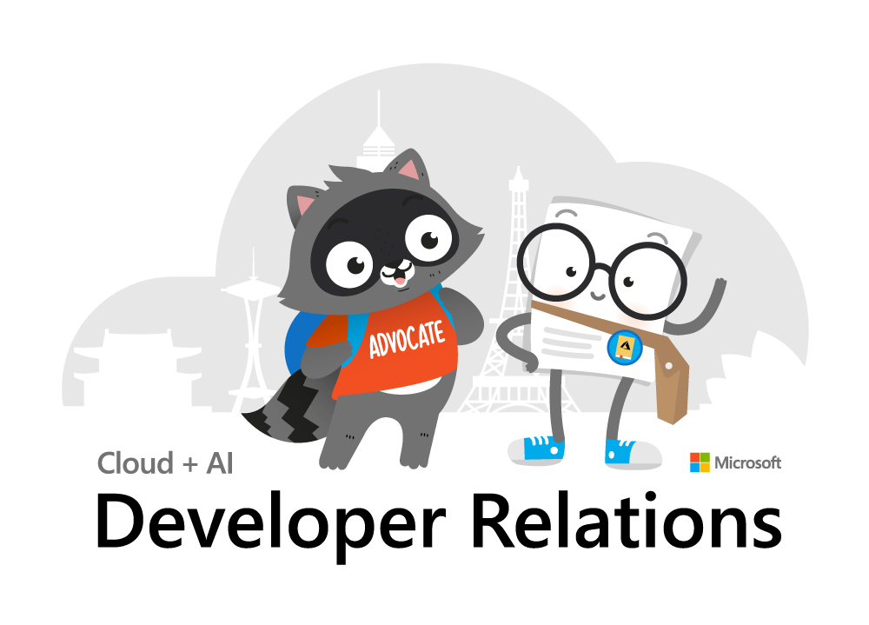
Inclusive Meeting Framework
Inclusive Meeting Framework Better experiences for everyone
Please practice these tips when in camp breakout sessions
Voice Guidance
Raise hand so the moderator can call on you.
State your name when speaking​ (every time).
Return to mute when not talking​.
Chat Guidance
Q: to preface questions
@mention to respond to an individual
Stay on topic
Use alt-text for images and gifs
Allyship
Seek to understand, not drive agreement.
Focus on ideas, not people.
Support & amplify peers​.
Avoid Acronyms
Created by Cory Fowler & Josee Martens https://aka.ms/bravespaces
Notes:
Show in every session to all attendees.

Slide 4
Agenda
SQL Authentication and Logins
SQL Server Permissions
Operational Security
Database Object Security
Special and Service Accounts
Notes:
Today we’re going to cover a lot of important foundational material about security, accounts, authentication. For folks new to SQL Server security design and administration, this will be a great foundation for your learning. For those experienced in SQL admin, this will be a thorough evaluation of what you know, or thought you know, and maybe some gaps in what you know. I think there is content in here to interest everyone in the SQL career lifecycle, and I’m not just guessing at that. I got my first DBA job in 2006. I’ve been giving a presentation on Security at User Groups and SQLSaturdays basics for years, it was one of the first topics I started speaking technically on a decade ago. As my own experience has deepened and broadened throughout my career, so has the content I build into this presentation. So I’m going to start basic, and build quickly from there, focusing my content around common hurdles and tasks that database administrators face, in the hopes of deepening or broadening your experience, as well.
I’m going to focus mostly on SQL Server and the SQL Server platforms in Azure today, I’m not going to talk about CosmosDB so much because that’s not where I lived in my past life as a SQL Server consultant or in my current role on the SQL Docs team.
But today we’re setting the stage for a good conversation around authentication and permissions, how permissions behave inside each database. We’re start first by introducing the way security things are normal configured, but we’ll also discuss weird ways they veer from the normal.

Slide 5
Section Title 3
Authentication and Logins

Slide 6
Principal vs Principle
Principal
(noun) a person who is in charge of some responsibility
Example: The principal consultant talked to the school’s principal.
(adj) original, most important
Example: The principal aim of a good DBA is to defeat wicked developers.
Principle
(noun) a rule, guideline or fact
Example: Our guiding principles are based on science.
Notes:
So this is a common grammar issue in the English language, the difference between principal, P-A-L and principle, P-L-E.
Both can be a noun, but PAL describes a person, a person who could be your “pal”. A principle PLE is an inanimate thing, like guiding principles, or being principled, a way to describe someone who follows a moral or ethical code.
So today, we’re really talking about both today. Principals, PAL, are also what SQL Server calls security objects in the database. Principles, PLE, guide how DBA’s should design and create securables in our servers and database.

Slide 7
A Principal’s Principles
We can all be Principled Principals
who follow Principal Principles of security.
Notes:
My title at my last consultant company was Principal Consultant, so this past Principal is going to share with you his Security Principles.

Slide 8
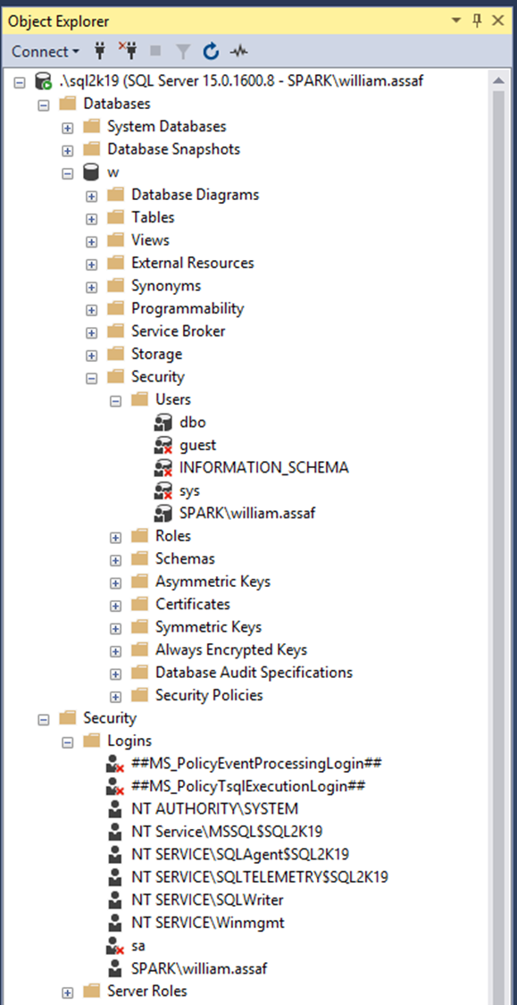
Login vs User
Database User
Server Login
Has a database context
Often linked to a Login*
Does not have a password*
Stored in a Database
Included in DB Restore
*Most of the time. We’ll talk about it.
Connects to a SQL Instance
Linked to AD (Windows Auth) or have a password (SQL Auth)
Stored in the Master database, so is not included in other DB restores
Notes:
<read notes!>
The Security Folders under Database and Server are highlighted. The Security folder under database has a subfolder for Users. The Security folder under server has a subfolder for Logins, and I’ve circled a login and a user here that have the same name.
<read slide>
So key takeaway here is that Logins handle authentication. Authentication can be through the trusted external system like Active Directory, or as an alternative, internally to the SQL Server in what’s called SQL Server authentication. SQL Server authentication on the face of it is simpler, contained, but we’ll talk later about how that’s actually advantageous for managing security.
Now, what have I already done wrong here?
I should create logins for to AD Security Groups, not individuals. Insist on it. Whenever possible credentials should be created for groups, not individuals. It’s best to use a security system that already has groups for many other purposes… a system like Active Directory. We can create groups in each SQL Server, but that’s not a scalable solution, is it? Roles can also be created as securables inside the SQL Server as well.

Slide 9
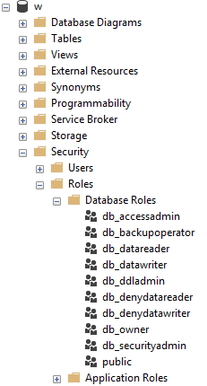
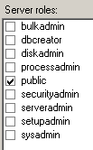
Server and Database Built-in Roles
Roles are security principals too
Logins added to Server Roles
Users added to Database Roles
Built-in Roles to provide a standard for access that may be too broad.
Follow principles of RBAC.
Notes:
<read slide first> RBAC is an acronym many in the governance area are familiar with, the idea that nobody gets permissions that are unique to them, they are only granted permissions based on their role, not their individual needs. Role Based Access Control means that creating specific permissions is a meaningful exercise, because it’ll be applied to members of a group. The last thing you want to end up with are many SQL Logins, each with their own permissions. This would make application maintenance and proper security auditing a nightmare. Instead, DBAs and developers work together to identify permissions needed per role, and then create custom Server Role and/or Database roles to grant those permissions.
When granting permissions to a role, assign more specific permissions when possible. While you can add a role to the built-in database roles, like db_datareader or db_datawriter, that might be overreach. Your data within a database may not be homogenous in terms of sensitivity/permissions to access.
Later, we’ll talk about schemas, these are also security principals, and great way to grant more specific permissions than to all objects in a database.

Slide 10
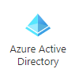
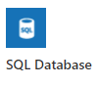
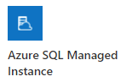
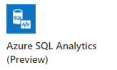
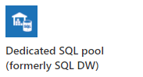
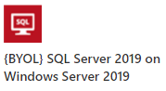
Role Based Access Control (RBAC)
Windows, AD, or preferably Azure AD makes this easier to accomplish.
Notes:
Let’s talk a little bit more about RBAC.
Role-based authentication is best when leveraging Active Directory (Azure or not), using security groups.
SQL Server Authentication can also be role based, using roles, but it is within each SQL instance and is not a centrally managed security system, so it is not a scalable solution. A better solution than managing each individual user’s accounts and permissions manually, of course, and the only option when Active Directory or Azure Active Directory are not an option. In general, we shouldn’t create database level credentials for people, with people’s names on them. And don’t fool yourself by creating admin1, admin2, admin3, for example.
A lot of what we’re talking about throughout this presentation applies to SQL Server, again whether it’s in a SQL Server instance on a VM in Windows or Linux or in Managed Instances, in all S.L.O.’s of Azure SQL DB, or in the SQL Server based nodes and pools of Big Data Clusters and Azure Synapse.
However, Azure Active Directory is an option in most of the SQL Server platforms on Azure, including the Dedicated SQL pools and Azure Synapse. “With Azure Active Directory authentication, you can centrally manage the identities of database users and other Microsoft services in one central location.”
Exceptions to this rule include Big Data Clusters, where SQL Authentication is the only option for SQL Server to SQL Server communication inside SQL Server Big Data Clusters (https://docs.microsoft.com/en-us/sql/big-data-cluster/concept-security?view=sql-server-ver15#encryption-in-flight-and-other-security-mechanisms), and Azure SQL Edge, currently only supports the built-in SQL Authentication mechanism.
Note here I am not talking about Azure users, groups, and permissions. For the most part those permissions are completely different than permissions inside a database, for good reason. Azure architects don’t need direct database access, and database admins and developers don’t need Azure access.
Now, I’m not done singing the praise of using Active Directory authentication, I’ll continue to do that later, but I want to point out one more thing here.

Slide 11
Public Roles
Every login/user is a member of “public”
All logins/users inherit permissions granted to public.
Public is a server role that should never be granted any additional permissions, authorization or ownership.
Public is also a database role. Every database user/role belongs to a public database role.
Notes:
On these sample image here, you’ll notice the public roles at both the server and database level, and how that server role public checkbox is always checked. And it can’t be unchecked. Let’s talk about public.
<read notes instead>
Every login is a member of the public server role. Every user in each database is a member of the that database’s public database role.
Only very lazy and short-sighted developers would grant permissions to public, which allows every user that does or ever will exist, to inherit permissions.
Permissions assigned to the public role is a clear sign of lazy developers. Let’s red flag that anywhere we see it, and never recommend it in any tutorials, walkthroughs, etc.
There’s always got to be a better way than granting permissions to public.

Slide 12

Public
Should fail any app security audit or DB audit.
Pay attention JEDI: This is STIG SV-53924r1_rule
However, expected non-issue findings from Database Diagram feature.
A pain to unravel.
Notes:
<read slide first>The strategy to undo a security architecture based around public can be complicated, involves lots of testing, almost certainly requires participation from the developers to figure out what permissions are actually needed.
In my past life I helped a state national guard audit its GIS software, and this STIG led to a vendor software uninstallation.
Source: https://www.stigviewer.com/stig/microsoft_sql_server_2012_database/2013-11-10/finding/V-41398

Slide 13


Server Logins + Database Users
A Server Login is what authenticates a connection to SQL.
A Database User provides a Login with database access.
Notes:
<read slide first>
“Login” is a server level security principal.
“User” is a database level security principal.
Now, let’s talk about the different types of SQL Server Logins, they’re differentiated by how they authenticated to SQL Server.

Slide 14
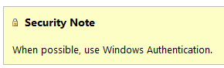
SQL Authenticated Logins
SQL Logins are authenticated by a SQL Server instance.
“Enforce Password Policy” encouraged, but not required!?
More administrative effort to maintain, migrate, secure.
Notes:
1. We’ll talk more about this but using SQL Authentication means each SQL Server is now an authority for its own credentials. If you have 10 SQL Server instances, that 10 different sets of logins and passwords to maintain, as opposed to one Active Directory.
2. Strongly encouraged to Enforce password policy, which can include password expiration, inheriting from the same settings in Windows.
Unfortunately, the password policy is optional! Password could be password, empty string, or the same as the user name.
Also, if a login doesn’t currently have the password policy enforced, you can check the box, but it doesn’t apply to the current password. So it’s way too easy to mark a login to apply policy, but have a password that is NOT strong enough to meet policy. The policy would only then be checked if it is changed.
3. Multiple failed SQL auth login attempts will Lock Out, which a DBA must resolve. Because these credentials are specific to each instance, it also means that SQL logins must be kept synchronized, more or less manually, between replicas in an Availability group
Finally, see here a plain and clear screenshot from Microsoft Docs. Use Windows Auth when possible. Don’t even enable SQL Auth unless you have to – it’s not enabled by default when you go to install SQL Server. You have to go out of your way to configure the instance in Mixed Mode, which enables SQL Logins and allows the built-in “sa” account to be enabled.

Slide 15
SQL Auth Passwords
Check for weak or easily predicted passwords.
Compare hash results to sys.sql_logins.password_hash.
Toolbox – 3 easy passwords.sql
Notes:
<read notes> Let’s talk more about the optional password policy in SQL Server.
If you’re a sysadmin, you can perform what is essentially a rainbow attack against your own SQL Server to look for weak or easily predicted passwords. You can do this because SQL Server makes the one-way password hash function available to you. So you can run any string through the hashing function, then, compare the one-way hash to what SQL Server stores. So while you can’t reverse engineer or decrypt a password, you can generate a hash of any string, then compare hashes. And you can do all of this without failing a login attempt or locking out a login.

Slide 16
Windows Auth vs SQL Auth
In a typical enterprise business environment,
Windows Authentication means that:
account creation/termination,
security group membership,
password policy,
are all handled by an existing corporate security administration infrastructure.
Notes:
<read notes first>
So we’ve talked about how SQL auth really creates additional administrative overhead and the fragmentation of security for user and even application access. In comparison to Windows Authentication, specifically using Active Directory, SQL Authentication creates a decentralized security setup in each instance.
<click, read slide>
Centralizing account and password management, role assignment, these are good things to do from a governance standpoint and from the standpoint of, that thing you see on Certification Exams all the time? “Least amount of administrative effort”
Proper use of the Windows Authentication model creates Server Logins that are linked to Domain Accounts, Preferably linked to Security Groups in Active directory, not individuals, so that membership is also managed by your existing security infrastructure.
Windows Authenticated Logins can also be created for Windows users, local to the Windows Server. This isn’t ideal, creating some of the decentralization and redundancy issues common for SQL Authenticated logins. Don’t recommend them except for potential use in SQL Servers outside of a domain.
In any case, SQL Server inherits the password policy of the local Machine Policy, regardless of whether or not the local Machine Policy is inherited from a Domain Policy.

Slide 17
Windows Auth and Apps
Using Windows Auth requires the OS to authenticate.
In Windows, this is the SSPI, which will authenticate via Kerberos or NTLM. This is non-trivial.
Kerberos requires Service Principal Name (SPN).
NTLM = old MS Authentication protocol that Kerberos replaced.
If you get SSPI issues, it’s likely a double-hop or trust issue.
Use Service Accounts in all cases, SQL or Windows Auth.
Notes:
Now, to be fair, Windows Authentication does have a complexity increase.
<click>
<read slide bullet points 1-5>
<read notes>
You may have encountered this before if trying to use Windows Authentication from an Internet-facing server, like an App Server in a DMZ, or otherwise outside of the domain. Kerberos may be required to authenticate a Windows User directly from the application server to the SQL Server. Can increase the complexity of an application loadout, but this is the Enterprise approach. I don’t have time to do a deep dive on this today, but this is fairly well documented and may involve your Active Directory admins helping to configure.
<click>
This is why I still see SQL Authentication used by many applications, because developers don’t want to have to ship applications that depend on this kind of trust. To be clear, this is less secure.
The best way to design this is that applications that SQL Logins at least use a SQL Login that isn’t used interactively.
When I say interactively, I meant that no human is ever typing in this user name and password. Make the password painfully long, even.
Make sure that developers themselves don’t use the SQL Login, they should still use their own Windows Authentication, even if they are external vendors. A defining characteristic of a Service Account is that nobody knows its password, and at least, it isn’t used interactively.
We’ll talk about service accounts more later on, and especially the different options around Windows Authenticated Service Accounts.

Slide 18
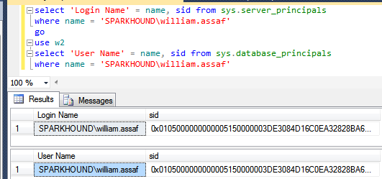
Logins + Users
A User can be linked to any Server Login
The names don’t actually have to match, but they should.
A SID (Security-IDentifier) is shared by User and Login.
Notes:
In Windows Authentication, that SID comes from the Windows provider, likely Active Directory. So in all SQL Servers where that domain account is used, it’s got the same SID.

Slide 19
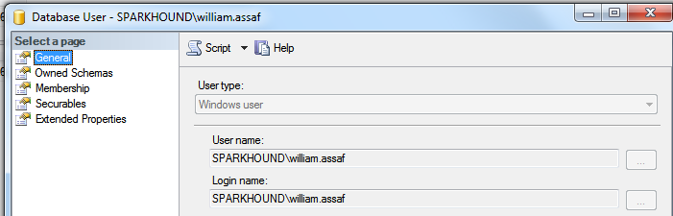
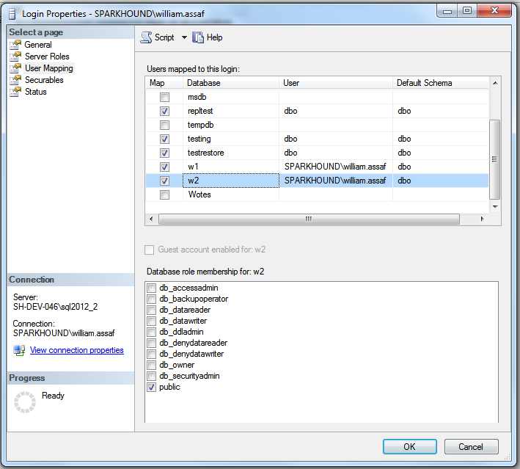
Login Mapping to Database User
Logins are mapped to Users in the User Mapping page of the Login properties dialog.
Notes:
It’s here in the mapping that users take on the SID of the login.
Note here also the user “dbo”, this is a special user in each database that sysadmins can use. We’ll talk more about dbo and its shifting uses over the years later on.

Slide 20
Orphaned SID
DB Users can be disconnected from their SQL Auth Login.
Commonly occurs when a database is restored from one SQL instance to another.
Only with SQL Auth Logins, not Windows Auth Logins.
SQL Auth Login = local SID, Windows Auth Login = AD SID
Notes:
<read slide>
Now, why is that? Why would this only affect SQL Authenticated Logins?
<click>
It’s because, unless you specify a SID yourself, the SID for a SQL Server is generated locally at each SQL instance. If you go and create a Login named test on 5 different SQL server instances, you’ll get a Login named Test with five different SIDs. There is a way to create a SQL Auth Login with a pre-determined SID, this is how migrations happen, we’ll talk about this in a bit.
If you create a Windows Login for the same Active Directory account on five SQL instances, each Login has the same SID, because all five SQL instances got the SID from the same place, AD. Therefore any user associated with the Login will have the same SID, on any SQL instance. This is becomes incredibly important for Availability Groups, where is much simpler to distribute an Windows Login from AD to each replica, versus distributing a SQL Server authenticated login to each replica, scripting it out to use the same SID in each instance.

Slide 21
Fix Orphaned SID
To re-associate a database user to a server login:
ALTER USER username WITH LOGIN = loginname;
SELECT DBUser_Name = dp.name
, Login_Name = sp.name
FROM sys.database_principals AS dp
INNER JOIN sys.server_principals AS sp
ON dp.name = sp.name
WHERE sp.sid <> dp.sid;
Notes:
To fix an orphaned SID and reunite the Login with its User, the command is actually quite simple. You can also proactively identify orphaned logins by comparing their names and SID in SQL Server’s internal metadata.
<click>
Here’s the basic join, and there’s a script in this session’s toolbox that helps you quickly identify and repair orphaned SIDs. For experienced DBAs in the field, remembering to look for and fix orphaned SIDs is a necessary followup any time a database is restored from one server to another, for example, to update a dev or test environment from production.

Slide 22
Contained Databases
Moves authentication from the Server level directly to the Database level.
A contained database owner, for example, has full control over security in the database.
No server-level (or sysadmin) permissions necessary
Notes:
So again, we’ve been talking about the difference between Logins and Users and how the SID, not the name connects them. Now, don’t forget everything I just told you, but… well, there’s this thing called contained databases.
<read slide>
Contained database has no configuration dependencies on the instance, it can be easily moved to another instance.

Slide 23
Users With Passwords
What this means is that this syntax, which heretofore made no sense, on a contained database is perfectly valid:
USE [Contoso_DB];
CREATE USER [BI_User] WITH PASSWORD ='strongpassword’;
--or
CREATE USER [Contoso\BI_User];
Notes:
So, this is that asterisk on my early slide, talking about how only server logins have passwords, database users are linked to logins… well, most of the time.
A contained database user is a database user… with a password. Or, a database user directly tied to a Windows User that does not exist as a login.
Here in contained databases, the user is the contained, portable method of authentication to the database.
In SQL Server, Authentication to a contained database can be made with Windows Auth accounts which don’t exist as Logins, or Contained Database Users where the password is maintained inside the database. That’s not how regular databases in SQL Server work of course.
Agent jobs, system error messages, linked server information, and system settings are all inside the contained database instead of master or msdb.

Slide 24
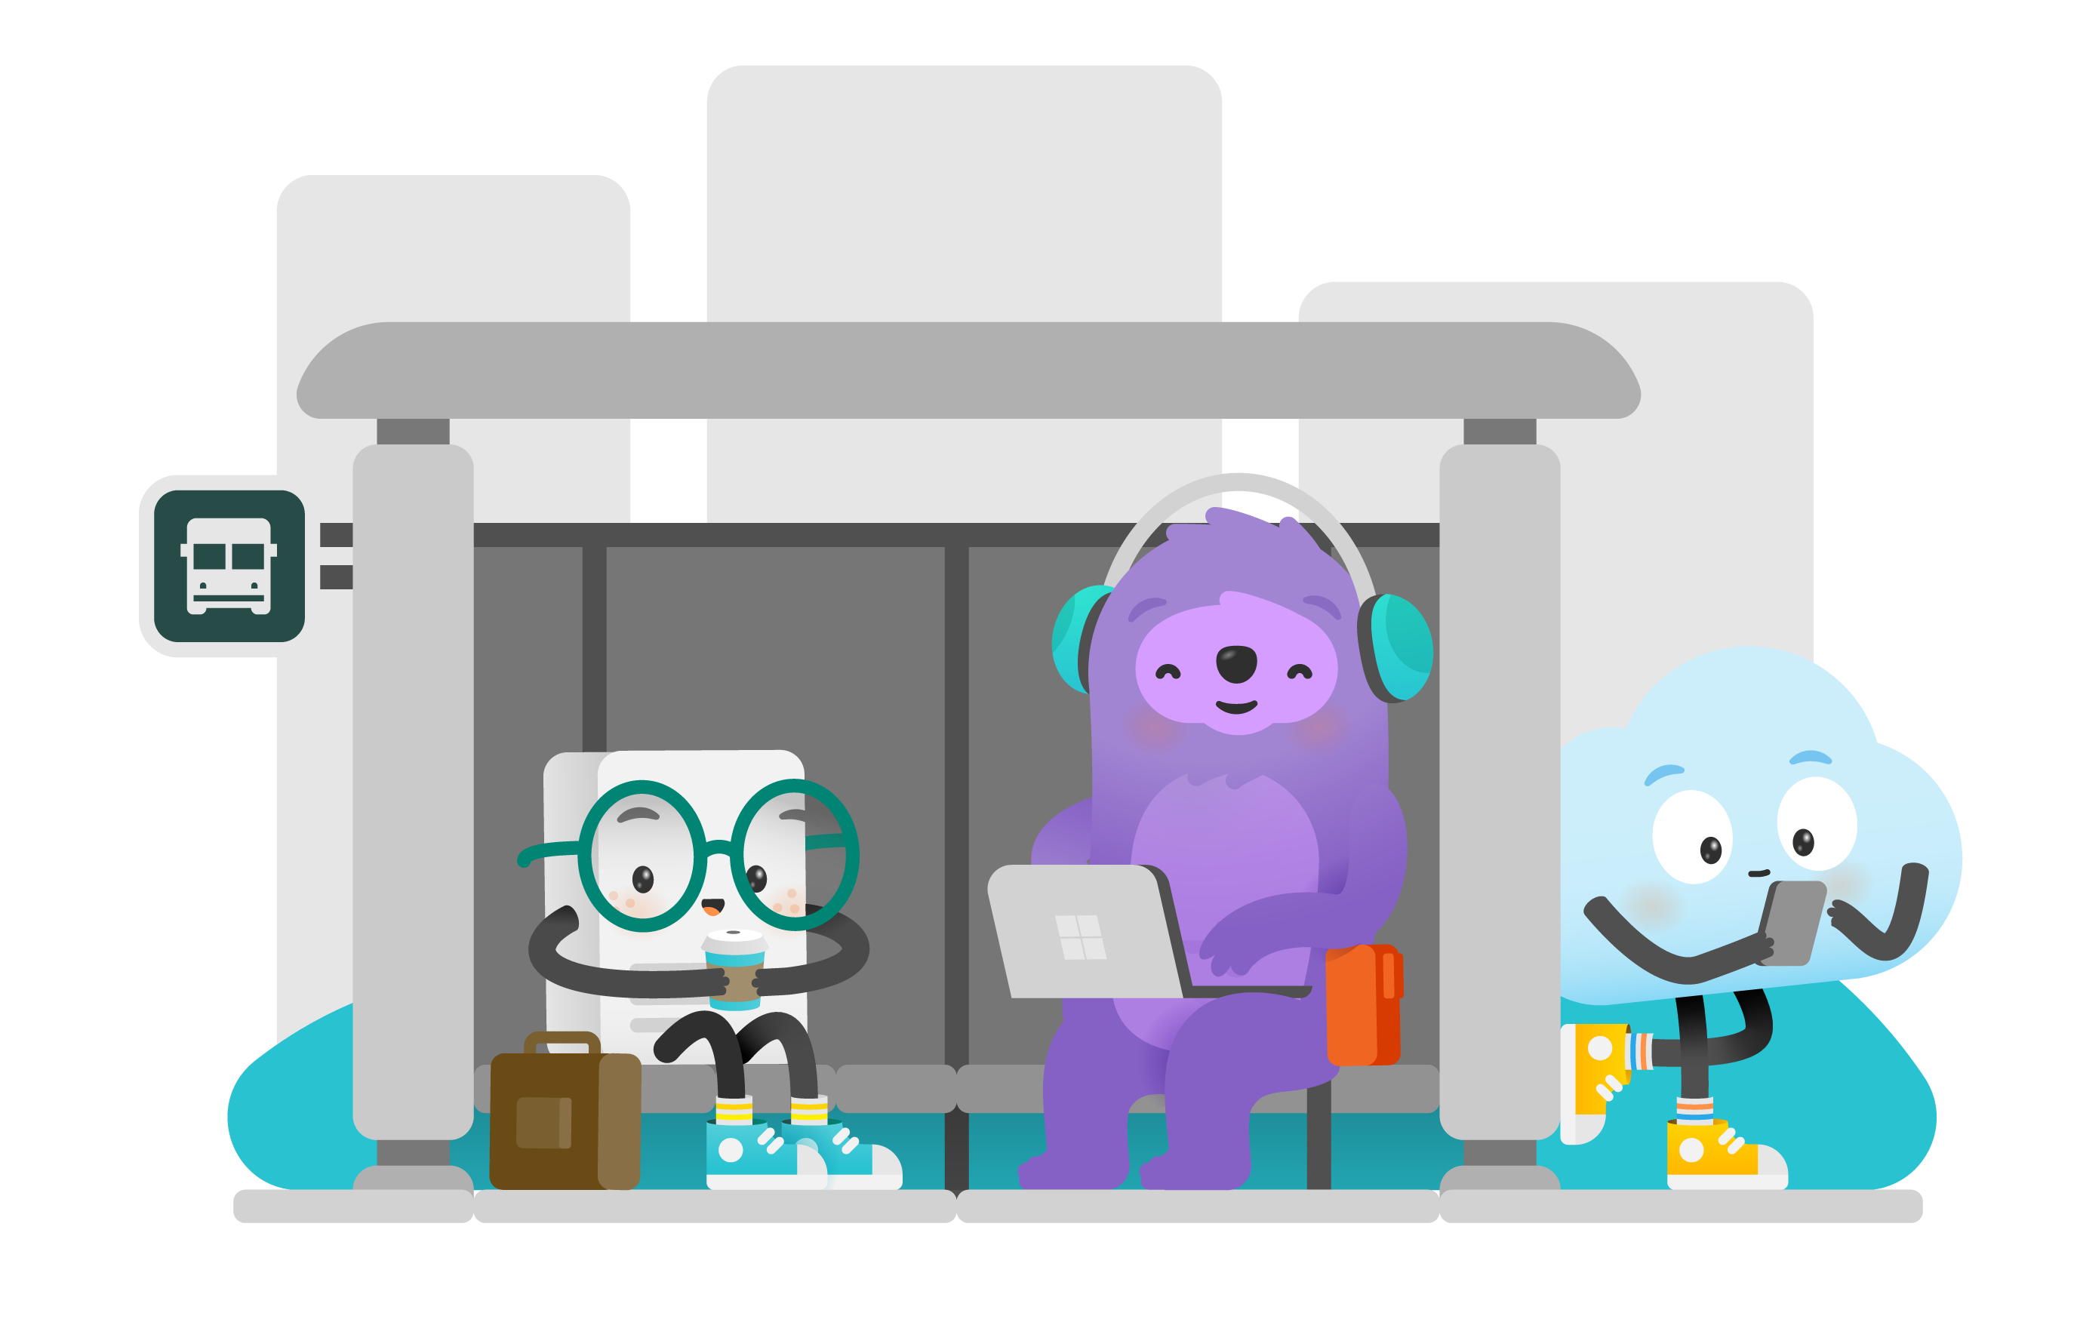
Contained Databases Sound Familiar
A platform where all the necessities for authentication and system objects are stored in the user database…
No system databases needed, so the database is easily portable between servers…
What does this sound like?
Azure SQL Database!
Image: https://docs.microsoft.com/en-us/azure/azure-sql/database/media/sql-database-paas-overview/architecture.png
Notes:
<read slide first>
This is the whole purpose of a contained database – unlimited portability on the back end, where Microsoft can move the database from instance to instance inside Azure without having any ties to the instance, everything is contained inside the database, including authentication. You don’t know or care what SQL instance your Azure SQL DB lives on, it’s completely contained and portable.
Microsoft developed contained databases for Azure, then brought the contained database feature to SQL Server, where it’s actually labeled partially contained because of some minor details.
Let’s briefly talk about how the authentication and security principals here are different.

Slide 25
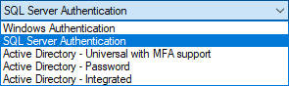
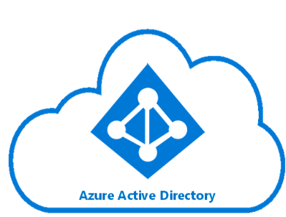
Azure SQL DB Authentication
Additional types of authentication since SSMS 2016
Image: https://docs.microsoft.com/en-us/azure/active-directory/hybrid/media/tutorial-federation/diagram.png
Notes:
The “Active Directory” dash options used for Azure AD only as Azure-based replacements for the Windows Authentication option. You can of course use SQL Auth for an Azure SQL Database, and that’s really your first and only option for environment once it is created, before you have integrated Azure AD.
For all the same reasons as Windows Authentication for SQL Server, using the Azure AD authentication in Azure SQL DB is superior.

Slide 26
Azure SQL Admin Logins
Azure SQL DB Servers are logical servers only.
Azure SQL Logins in master can be shared across databases.
You initially create one full admin SQL Authenticated login per Azure SQL database logical server.
You can create one Azure Active Directory administrator account with full administrative permissions as well.
You must maintain logins on each Azure SQL logical server in active geo-replication or auto-failover groups.
Notes:
<read notes instead>
Azure SQL DB <airquote> “servers” are logical servers only. And I say logical server because in the Azure SQL Database product, all the databases are contained. Unlike the master database in SQL Server, the “master” database here can only store certain objects, and behaves for the most part read-only.
<click>
Just like in SQL Server, Azure SQL Logins can be created in master and linked to a SQL Authenticated user in a user database, if you choose to create multiple Azure SQL databases in the same logical server.
<click>
Initially, the admin account that you specify upon creating an Azure SQL DB exists as a SQL authenticated user, with administrative rights to all databases on the server.
That’s the only full admin login on the logical server that uses SQL Authentication, and you can’t create another.
<click>
You can create a second full administrator, this time using Azure Active Directory. Just like in SQL Server, it can be created for an Azure Active Directory individual account or a security group, with a security group preferred. Often, I see database folks creating their own Azure AD account as the Azure Active Directory admin. Watch out for that antipattern, and use security groups for the role of the DBA or Database Developer as much as possible.
<click>
Like I said in Azure SQL DB, you can have logins in the master database. And while this is the pattern you use for a SQL Server instance, but more commonly you’ll have contained users in each database. In Azure SQL Databases in active geo-replication or auto-failover groups, there’s that complexity of needing to maintain the Azure SQL DB logins on each server, manually, just like you would need to create and maintain the logins on each SQL Server of an availability group. In that case, leveraging contained database users only is probably going to be reliable over time.

Slide 27
Azure SQL DB + Azure AD
You can use Azure Active Directory accounts only for Azure SQL contained database users, but not for Azure SQL server logins. Example:
CREATE USER [reportuser@domainname.onmicrosoft.com] FROM EXTERNAL PROVIDER; --different from SQL Server
You must add the Azure AD admin via the Azure Portal first.
Only Active Directory accounts can create other Active Directory accounts in Azure SQL Database.
Notes:
One more caveat about Azure AD accounts and Azure SQL Databases,
<read slide>
That’s really the only complication, and it’s one you’ll probably forget sooner or later. Only in Azure SQL DB, you have to be logged in with an Azure AD Account to create logins or contained users for other Azure AD Accounts.

Slide 28
Database Object Security
Database Object Security
Notes:
Now I’m going to talk a little bit about database object permissions inside the database. I’ll assume you know the basics of GRANTing permissions, some of the basic read and write access permissions inside SQL Server as well. If you don’t, that’s ok, they’re obviously named. I’ll also assume you’re familiar with the table, the basic storage object of any relational database, where rows are queryable by end users. It’s the relationship between that data in the table, and the user’s end queries that I want to explore with a simple exercise.

Slide 29
Stored Procedures
Stored procedures require EXECUTE to run, and do not require underlying permissions (SELECT, INSERT, DELETE)
… Assuming:
1. the sproc doesn’t perform IDENTITY_INSERT on a table, which requires ALTER permissions not abstracted.
2. all the underlying objects have the same ownership chain.
3. the sproc does not use dynamic sql commands like: exec sp_executesql @SQL or EXEC(@SQL)
Notes:
<read notes first>
Stored procedures are kindof a big deal, and we take them for granted. A big Synapse competitor, Snowflake for example, just straight up doesn’t have stored procedures.
<read slide>
That last one is the big one, it’s the basic commands for executing strings of TSQL as dynamic SQL, this is a pretty big security no no and one common reason for why SQL injection attacks are successful. Stored procedures help insulate applications against SQL injection attacks. Even if you’re not a developer, everyone needs to be aware of what SQL injection attacks are because most public data entry forms and websites are under constant, automated SQL injection attacks.

Slide 30
Stored Procedures Security
Given those conditions, thanks to the database permission chain, you could in theory:
GRANT EXEC rights to sprocs that INSERT UPDATE and SELECT from a table.
GRANT no other permissions to the table!
Users can read data from table using sproc ONLY.
Notes:
That way, no unauthorized SQL statements can be injected into the database via vulnerabilities in data entry forms.

Slide 31
Views
Very similar to stored procedures, SELECT permission to query a VIEW will allow a user to SELECT data from table(s) to which the user does not have access.
GRANT SELECT ON [view] … is all you’d need.
Notes:
<read slide first, then notes>
(This is helpful!)
GRANT SELECT ON VIEW is all you’d need, instead of granting access to the underlying tables. In this way you can provide a horizontal or vertically partitioned view of data, excluding certain secure columns for example, or rows. This is a way to essentially perform row-level security. However, it’s not the only way.

Slide 32
Row Level Security
SQL 2016+ feature based on inline table-valued functions and a security policy.
Allows to you apply security policy to specific users, filtering specific tables.
Can block reads and writes against tables, without the use of triggers.
Notes:
<read notes>
This is a feature across all platforms, Azure SQL Database, Managed Instance, Azure Synapse Analytics, as well as SQL Server since SQL 2016.
<read slide>
This is useful, especially for reporting, but also for environments where databases have a variety of applications developed against them. You may have legacy databases with a mixed security environment of legacy and modern applications, perhaps low-code applications and mobile applications as well, and you want to help developers enforce a single, consistent row-level security policy at the database level. This feature like many others is very well documented with lots of samples on docs.Microsoft.com to help you implement.
https://docs.microsoft.com/sql/relational-databases/security/row-level-security

Slide 33
User-Defined Functions
Similar to views, a UDF will allow a user to SELECT data from tables that the user does not have access to.
Keep in mind the performance impact of functions can be severe, especially in the SELECT portion of a query.
Overuse of UDF’s are common causes for performance issues. High potential for cursor-like effects.
New features in 2017 and 2019 addressed bad performance issues
Notes:
Some of the performance issues with UDF’s were addressed in the last two releases of SQL Server.
In SQL 2017 the performance feature Interleaved Execution helped with performance of Table Value Functions.
In SQL 2019 the new scalar function in-lining feature helped reduce the negative performance impact of abused scalar User Defined Functions.

Slide 34
Demonstrate how Stored Procedures, Views, and Functions abstract the permissions necessary to SELECT underlying table data. Security p1.sql – logged in as sysadmin Security p2.sql – logged in as testing user

Slide 35
Wrapup Section
Wrapup

Slide 36
More Resources
STRIKE trainings:
Cloud Security Incident Response Readiness Training
Security Foundations Training
Certification Exams:
Exam AZ-500: Microsoft Azure Security Technologies
Exam DP-203: Data Engineering on Microsoft Azure (beta)
Learn:
Security Overview - Azure SQL Database & Azure SQL Managed Instance
Securing SQL Server - SQL Server
Secure your data with Azure SQL - Learn

Slide 37
Continued reading
http://msdn.microsoft.com/en-us/library/ms191291.aspx
https://docs.microsoft.com/en-us/sql/connect/oledb/oledb-driver-for-sql-server?view=sql-server-2017
https://blogs.msdn.microsoft.com/sqlnativeclient/2017/10/06/announcing-the-new-release-of-ole-db-driver-for-sql-server/
https://techcommunity.microsoft.com/t5/SQL-Server/ODBC-Driver-17-for-SQL-Server-Released/ba-p/385825
http://social.technet.microsoft.com/wiki/cfs-file.ashx/__key/communityserver-wikis-components-files/00-00-00-00-05/5710.Permissions_5F00_Poster_5F00_2008_5F00_R2_5F00_Wiki.pdf
http://msdn.microsoft.com/en-us/library/bb669058(v=VS.110).aspx
http://blogs.msdn.com/b/sqlsecurity/archive/2011/08/25/database-engine-permission-basics.aspx
http://msdn.microsoft.com/en-us/library/ms191465.aspx
https://docs.microsoft.com/en-us/sql/relational-databases/databases/security-best-practices-with-contained-databases?view=sql-server-2017
https://azure.microsoft.com/en-us/blog/azure-sql-database-threat-detection-your-built-in-security-expert/
https://www.slideshare.net/GrantFritchey/sql-injection-what-it-is-how-to-stop-it
http://technet.microsoft.com/en-us/library/ms187359.aspx
http://support.microsoft.com/kb/918992
https://azure.microsoft.com/en-us/documentation/articles/sql-database-aad-authentication/
https://azure.microsoft.com/en-us/documentation/articles/sql-database-manage-logins/
https://docs.microsoft.com/en-us/dotnet/framework/data/adonet/sql/server-and-database-roles-in-sql-server/
https://docs.microsoft.com/en-us/sql/relational-databases/security/row-level-security?view=sql-server-ver15
https://docs.microsoft.com/en-us/sql/database-engine/configure-windows/configure-windows-service-accounts-and-permissions?view=sql-server-ver15

Slide 38
Thank you aka.ms/campfeedback

Slide 39

William Assaf
he/him
Senior Content Developer
SQL-Docs aka Rogue1
in/williamdassaf
@william_a_dba

